Slide 1
SlicerIGT Ecosystem: Introduction to Plus, SlicerIGT and Sequences
Kyle Sunderland, Andras Lasso
(1krs1@queensu.ca, lasso@queensu.ca)
May 25, 2022
Laboratory for Percutaneous Surgery
Queen’s University

Slide 2
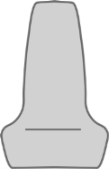
Introduction
PLUS – Public software Library for UltraSound imaging
Goal: Facilitate rapid prototyping of ultrasound-guided intervention systems for translational clinical research
Acquire, process, transfer synchronized image and position data
Ultrasound
computer
Tracker
Reference
Needle
Probe
3D Slicer
computer
Image
Phantom model
Notes:
Open source software library developed in Perk Lab
Rapidly prototype image guided systems for use in clinical research
Aquire and manage data from imaging and tracking modalities
Merge to single data source

Slide 3
Plus Toolkit Introduction
My Algorithm
My Interface
My Tracker
My Algorithm v2
My Interface v2
My New Tracker
My Algorithm
PLUS
My Tracker
My New Tracker
Notes:
To use algorithm + tracker software might be implemented like. (A)
Good for 1, but for >1 results in duplicated work
Need to implement new interface and modify algorithm to support
Plus: only need to adjust single file to completely change hardware
Output from Plus always in consistent format
Many devices supported
Adding support only requires interface between Plus and hardware

Slide 4
System Overview
Hardware (ultrasound, tracker, etc.)
PLUS
SlicerRT
Slicer
…
PerkTutor
SlicerIGT (Calibration, Visualization)
Image Overlay
…
Notes:
End up with workflow that looks like this:
Low level hardware
Connected to Plus
Broadcast to Slicer over OpenIGTLink
Processed in modules

Slide 5

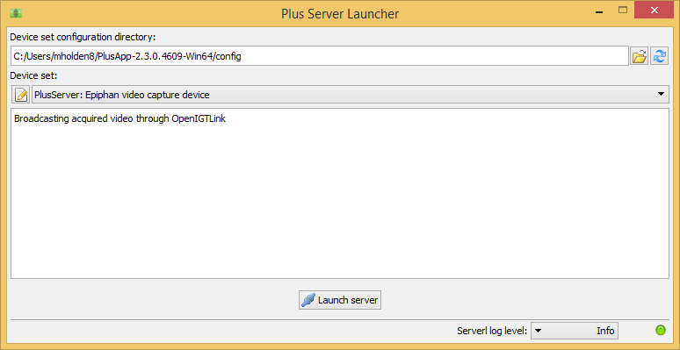
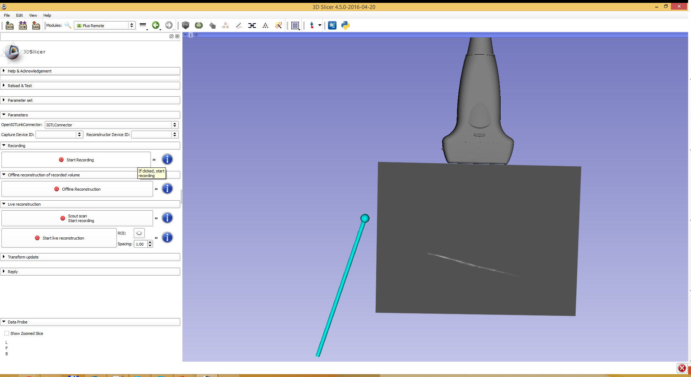
Plus Server Application
Connect to hardware devices
Broadcast data via OpenIGTLink (e.g. to 3D Slicer)
Remote control access from 3D Slicer
Start/stop device connections
Data recording
Volume reconstruction
Notes:
Main application: PlusServer
Connect devices and transmit data over OpenIGTLink
(Open source network communication protocol)
Plus server launcher
Select configuration and start
Controlled remotely from Slicer

Slide 6
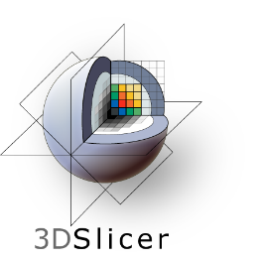
Plus Server Application
PLUS
Ultrasound
computer
OpenIGTLink
Tracker
Slicer
Needle
Probe
Reference
3D Slicer
computer
Image
Phantom model
Notes:
Single config file, set up connections like…
Describe connections

Slide 7
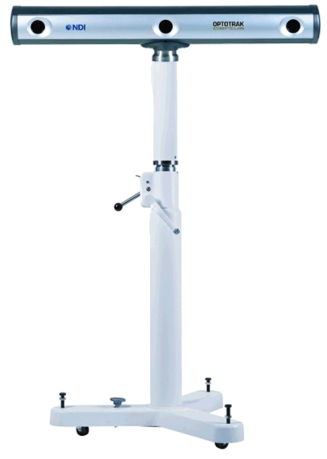
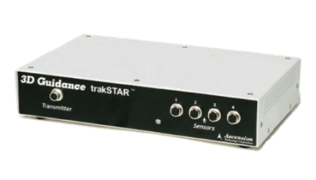
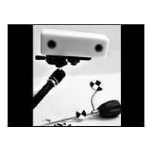
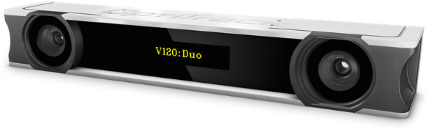
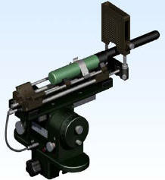
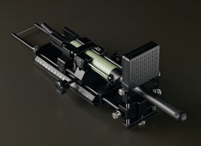
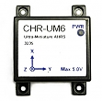
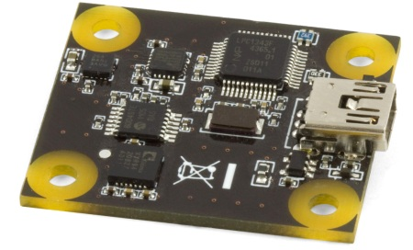
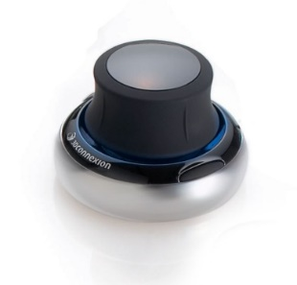
Data Acquisition - Tracking
Ascension EM tracker
NDI Aurora, Polaris, and Certus optical and electromagnetic trackers
Claron MicronTracker optical tracker
OptiTrack optical trackers
Brachy steppers (CMS Accuseed, Burdette Medical systems, CIVCO)
PhidgetSpatial inertial measurement device
CHRobotics inertial measurement device
3dConnexion SpaceNavigator 3D mouse
OpenIGTLink (for BrainLab, Siemens MRI scanners, and other compatible devices)
Software devices: file source, US simulator
Notes:
Plus supports many different tracking devices (list is not exhaustive)
Red stars are hardware that we have access to
Green stars are virtual devices that don’t require a piece of hardware

Slide 8
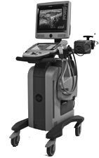
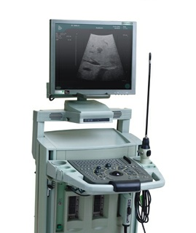
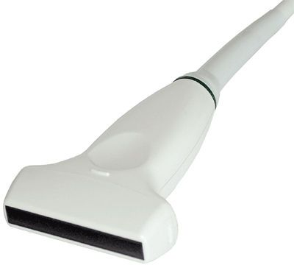
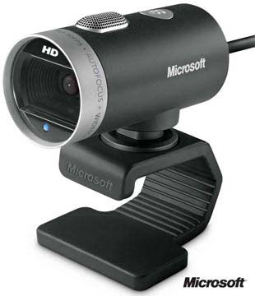
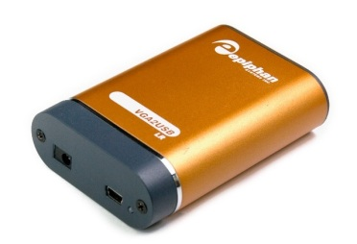
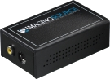
Data Acquisition - Imaging
Ultrasonix: B-mode & RF (through research interface)
BK ProFocus: B-mode & RF (through research interface)
Telemed ultrasound
Clarius ultrasound
ImagingControl framegrabbers
Epiphan framegrabbers
Webcam video
OpenIGTLink (for MUSiiC, Siemens MRI scanners, and other compatible devices)
Other software devices: file source, US simulator
Notes:
Similarily, Plus also supports a wide variety of Imaging devices

Slide 9
Pipeline
EM Tracker
Tracking Channel
Virtual Capture
Virtual Mixer
Combined Channel
Image Channel
Visualization Client
Ultrasound
Data Flow
Devices are the creation point of data
Record, simulate, process “external” data
Channels are the communication point between devices
Outputs tracked frames for client consumption
Notes:
Explain what a mixer device is
Explain what a capture device is
Example pipeline in Plus
Inputs are:
Produce data channels
Virtual mixer
Combine channels to a single output
Virtual capture
Record data
Output to client

Slide 10
Example: Tracked Video
Internal data sources
Output Channel
Output Channel
Video
Video
Input Channel
Video
VideoDevice
Video
ProbeToTracker
Input Channel
ReferenceToTracker
Internal data sources
Output Channel
ProbeToTracker
StylusToTracker
ProbeToTracker
ProbeToTracker
ReferenceToTracker
ReferenceToTracker
ReferenceToTracker
StylusToTracker
StylusToTracker
StylusToTracker
MixerDevice
TrackerDevice
Notes:
By setting up the XML in this format, we have specified
What we are retrieving from hardware (transform, image names)
What devices we are transmitting the information to
What data we are sending over OpenIGTLink

Slide 11
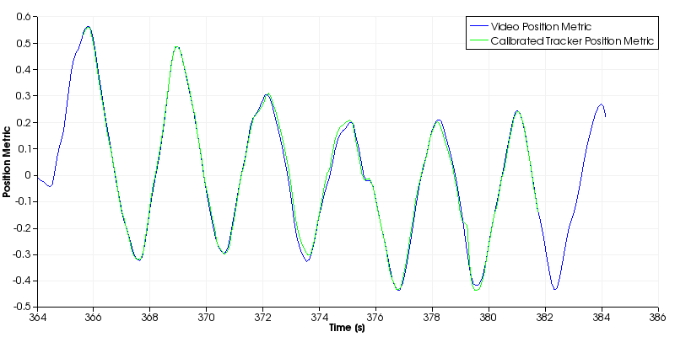
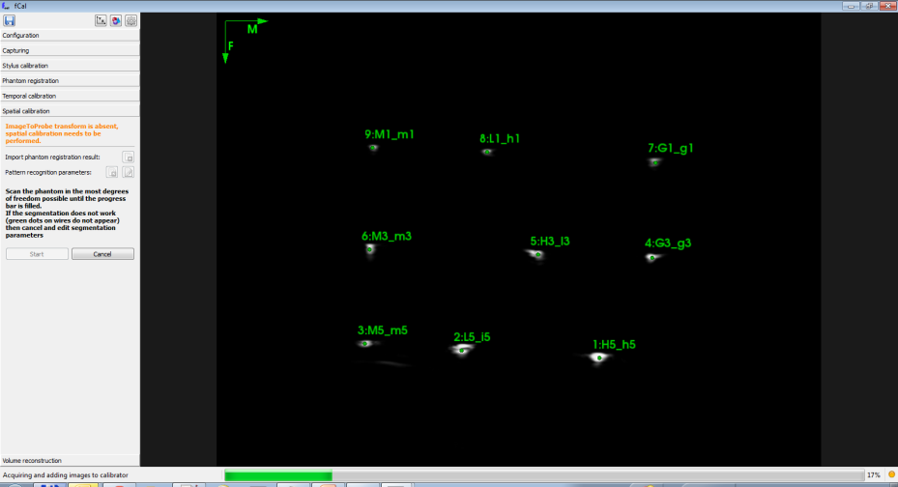
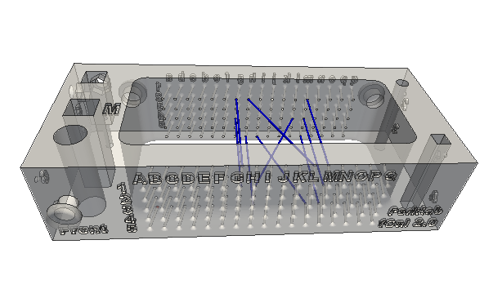

fCal Application
fCal (Freehand tracked ultrasound calibration application)
Temporal ultrasound calibration
Spatial ultrasound calibration
fCal phantom
Notes:
Other application fCal
- Used for temporal + spatial calibration
Temporal calibration
How
Why
Spatial calibration
How

Slide 12
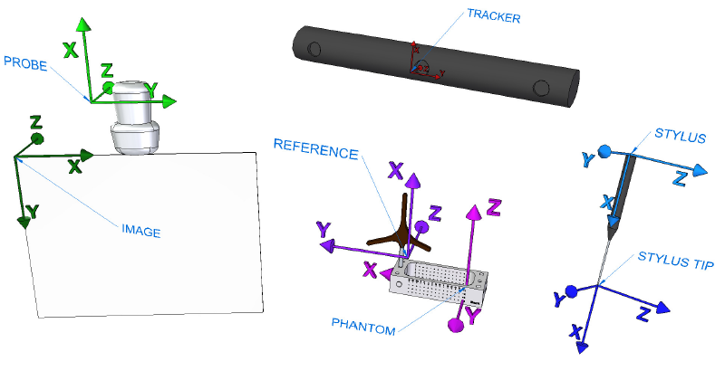
Spatial Calibration
Goal: determine the transform between coordinates systems
Notes:
Spatial calibration
Why
- Corner of the image relative to the probe
- Scale of the image in mm

Slide 13
Sequence Files
Timestamped image and transform recording
Based on the Meta IO standard image file format (.mha, .mhd)
Images readable by many existing applications (e.g. 3D Slicer)
Extra information for tracking/reconstruction
Image orientation
Transforms from tracker
Tracker and image status
Timestamps
etc.
Usable by all Plus applications
Notes:
In addition to streaming data, Plus can also record data in Sequence files
Contain synchronized image and transform data
Based on the MetaIO format developed in ITK
Sequences can be used in other applications such as 3D Slicer
Both PlusServer and fCal can read and replay sequence files, as well as perform other algorithms such as volume reconstruction

Slide 14
Sequence Files
ObjectType = Image
NDims = 3
BinaryData = True
BinaryDataByteOrderMSB = False
CompressedData = True
DimSize = 820 616 97
ElementType = MET_UCHAR
…
UltrasoundImageOrientation = MF
Seq_Frame0000_ProbeToTrackerTransform = 0.956683 -0.263308 0.124204 -190.886 0.269031 0.962616 -0.0315089 -98.0911 -0.111264 0.0635588 0.991756 -1949.07 0 0 0 1
Seq_Frame0000_ProbeToTrackerTransformStatus = OK
Seq_Frame0000_ReferenceToTrackerTransform = 0.260287 0.964665 0.0408926 -208.632 -0.96117 0.262899 -0.0838866 -115.511 -0.0916731 -0.0174702 0.995636 -1992.7 0 0 0 1
Seq_Frame0000_ReferenceToTrackerTransformStatus = OK
Seq_Frame0000_StylusToTrackerTransform = 1 -8.43482e-005 0.000190641 0.370779 8.39344e-005 1 0.000146179 0.316166 -0.00019069 -0.000146138 1 -0.0640528 0 0 0 1
Seq_Frame0000_StylusToTrackerTransformStatus = INVALID
Seq_Frame0000_Timestamp = 345.627957
Seq_Frame0000_ImageStatus = OK
…
Seq_Frame0096_StylusToTrackerTransform = 1 0.000362791 -8.01739e-005 -0.106056 -0.000363818 1 -0.000369765 -0.839888 8.00139e-005 0.000370927 1 0.0862409 0 0 0 1
Seq_Frame0096_StylusToTrackerTransformStatus = INVALID
Seq_Frame0096_Timestamp = 355.783014
Seq_Frame0096_ImageStatus = OK
ElementDataFile = LOCAL
xœìÝw...
EditSequenceFile.exe
Editor for sequence files
ViewSeqMetaFile.exe
Replay saved sequence files
Notes:
Point out features
Metadata
Transform
Status
Other applications:
Edit
Replay

Slide 15
PLUS Configuration Files
Notes:
Need to be able to write config files
What are they?
XML
What hardware
What processing
What connections (devices)
What output

Slide 16
XML Basics
Element: XML element is an entry in an XML file
<Unicorn/>
Attribute: XML attribute is a property of an element
<Unicorn realness=“notReal” size=“12” />
Example:
<Animals>
<Animal species=“Unicorn” realness=“notReal” size=“12”/>
<Animal species=“Elephant” realness=“real” size=“50”/>
</Animals>
Notes:
Element
Object in tag
Has name
Attribute:
Defines properties of an element
Can have nested elements.

Slide 17
Config File Terminology
Hardware: Any physical or virtual device
An EM position tracker
Device: The interface to a hardware
Interface to EM position tracker
Data Source: A construct around a buffer containing meta information (e.g. what type of source)
The tracking data for the ultrasound probe
Channel: A construct representing a stream of data
The combined tracking data

Slide 18
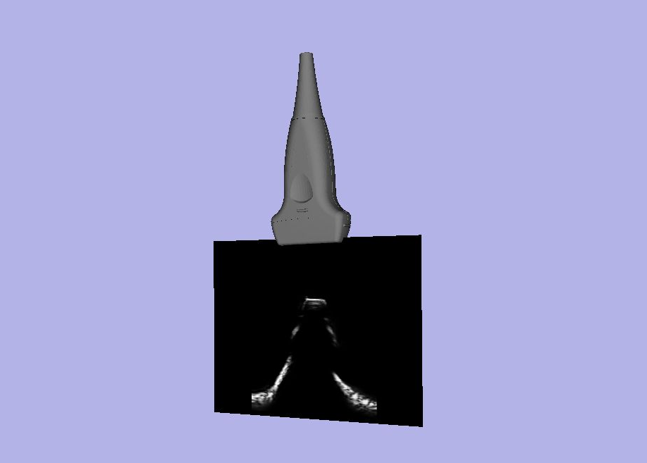
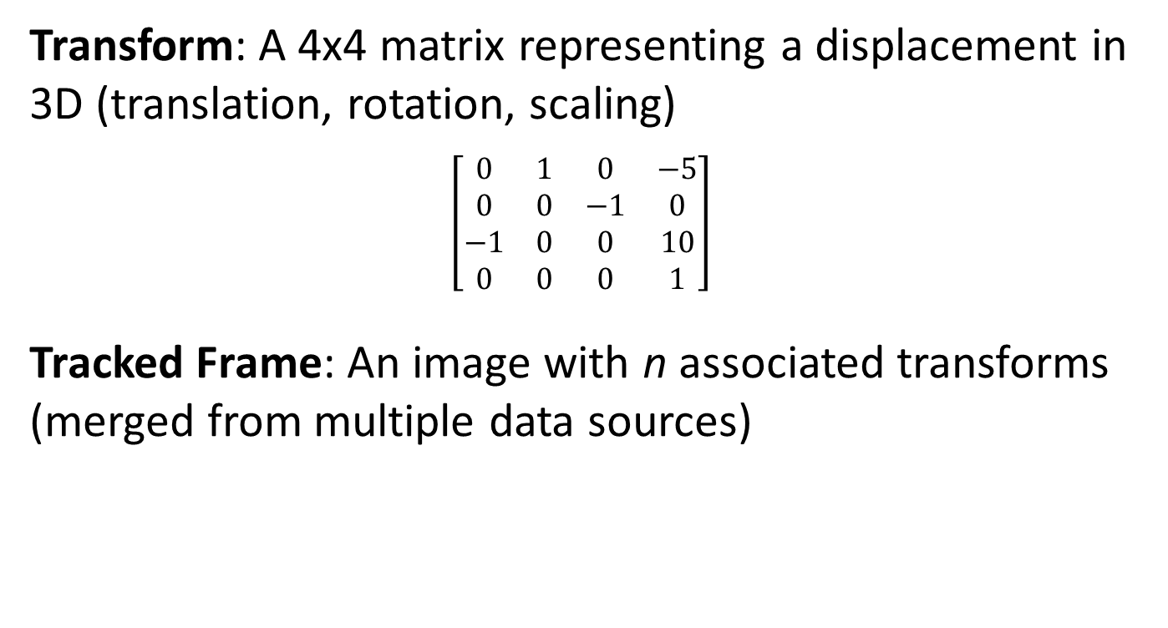
Config File Terminology
Transform: A 4x4 matrix representing a displacement in 3D (translation, rotation, scaling)
$$\left[\begin{matrix}0 & 1 & 0 & −5 \\ 0 & 0 & −1 & 0 \\ −1 & 0 & 0 & 10 \\ 0 & 0 & 0 & 1\end{matrix}\right]$$
Tracked Frame: An image with n associated transforms (merged from multiple data sources)

Slide 19
Configuration Files
<PlusConfiguration> - Root element
<DataCollection> - Where the devices/channels all go
<DeviceSet/> - Information about the config file
<Device/> - Physical or virtual hardware
</DataCollection>
<CoordinateDefinitions/> - Constant transforms
<PlusOpenIGTLinkServer/> - What to send over OpenIGTLink
</PlusConfiguration>
Notes:
Emphasize the linkage by ID, give them a basis to understand other config files
Within the config file, the elements can be stored within these tags
DataCollection contains all of the device and channel information
And finally CoordinateDefinitions can contain hardcoded transforms (for applications like ultrasound calibrations)
PlusOpenIGTLinkServer sends data from a single channel over openigtlink using the specified connection information

Slide 20
Example: Tracked Video
Linking input & output via channels
Device -> channel -> device (repeat)
<Device
Id="TrackerDevice“
Type="Ascension3DG“
ToolReferenceFrame="Tracker"
... >
<DataSources>
<DataSource Type="Tool" Id="Probe" PortName="0" />
<DataSource Type="Tool" Id="Reference" PortName="1" />
<DataSource Type="Tool" Id="Stylus" PortName="2" />
</DataSources>
<OutputChannels>
<OutputChannel Id="TrackerStream" >
<DataSource Id="Probe"/>
<DataSource Id="Reference"/>
<DataSource Id="Stylus"/>
</OutputChannel>
</OutputChannels>
</Device>
<Device
Id="VideoDevice“
Type="SonixVideo“
ImageToTransducerTransformName="ImageToTransducer“
... >
<DataSources>
<DataSource
Type="Video“
Id="Video“
PortName="B“
PortUsImageOrientation="UF" />
</DataSources>
<OutputChannels>
<OutputChannel
Id="VideoStream“
VideoDataSourceId="Video" />
</OutputChannels>
</Device>
<Device Id=“MixerDevice" Type="VirtualMixer" >
<InputChannels>
<InputChannel Id="TrackerStream" />
<InputChannel Id="VideoStream" />
</InputChannels>
<OutputChannels>
<OutputChannel Id="TrackedVideoStream"/>
</OutputChannels>
</Device>
Notes:
Emphasize the linkage by ID, give them a basis to understand other config files
Example pipeline
using an Ascension EM tracker and an Ultrasonix ultrasound machine

Slide 21
Some Advice
Do NOT start from scratch
Plus website contains documentation and config files for devices: http://perk-software.cs.queensu.ca/plus/doc/nightly/user/Configuration.html

Slide 22
PLUS Configuration File Tutorial

Slide 23


Laptops/Webcams/Markers
Plus is only available to download for Windows
Hands-on tutorial requires a Windows computer + webcam
Have your printed ArUco markers ready

Slide 24
Download & Install PLUS
From: http://perk-software.cs.queensu.ca/plus/packages/stable/
Choose: PlusApp-…-Win64.exe
NOT Ultrasonix/Telemed/etc.

Slide 25

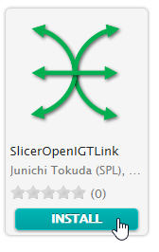
Download & Install Slicer
From: https://download.slicer.org/
Choose: Slicer 5.0.2 (Stable release)
Install SlicerOpenIGTLink and SlicerIGT extensions
Open Extensions manager
Switch to “Install Extensions” and search for “SlicerOpenIGTLink” and “SlicerIGT”
Click INSTALL
Restart Slicer

Slide 26
PLUS Configuration File Tutorial: Webcam

Slide 27
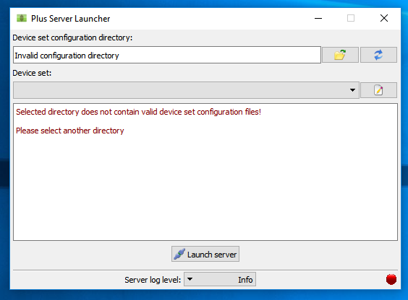
Start PLUS Server Launcher

Slide 28
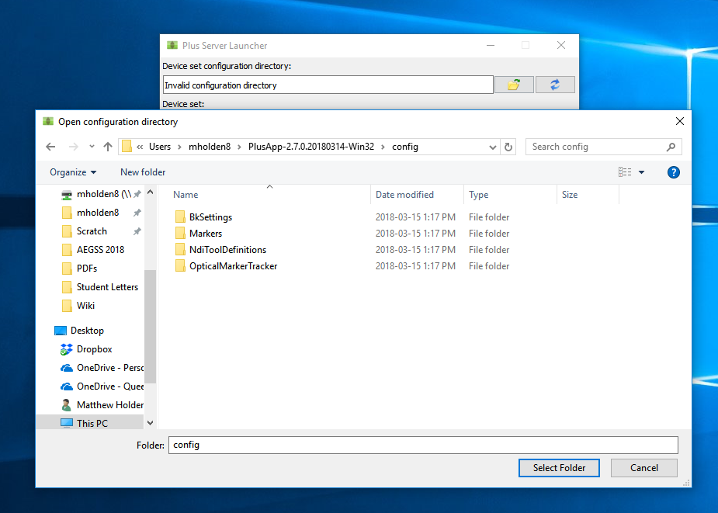
Select Configuration File Directory
1
2
Directory where you installed PLUS (C:/Users/<YourUserName>/PlusApp-…-Win32/config)
Choose “config” subdirectory
3

Slide 29
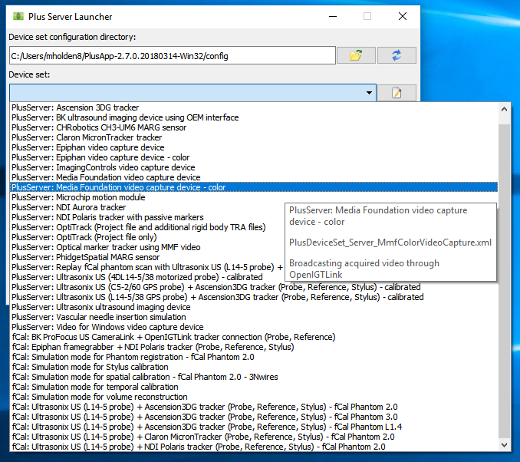
Choose Configuration for Color Video
1
2

Slide 30
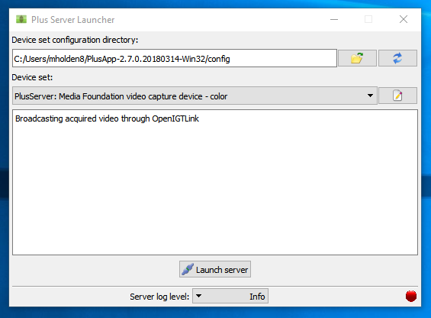
Launch Server
1
May take a few seconds…

Slide 31
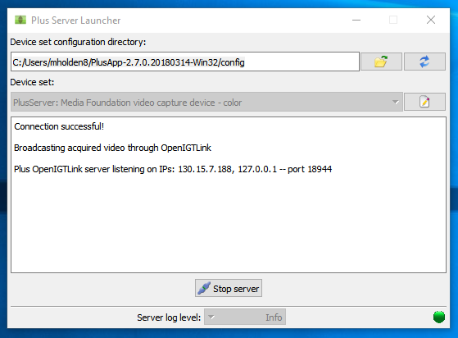
Check Connection
See

Slide 32
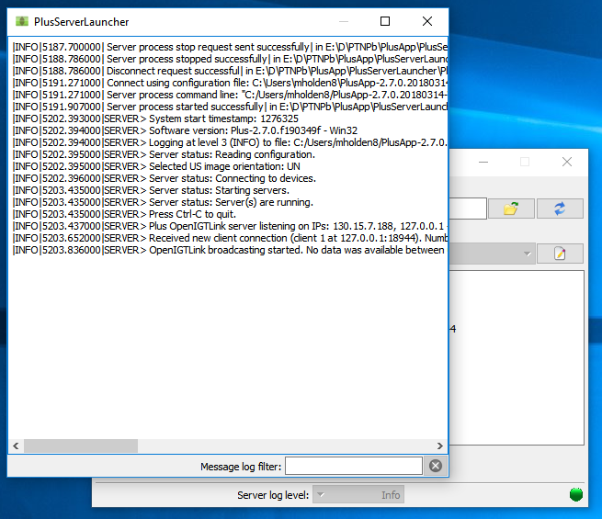
Check Message Log
1

Slide 33
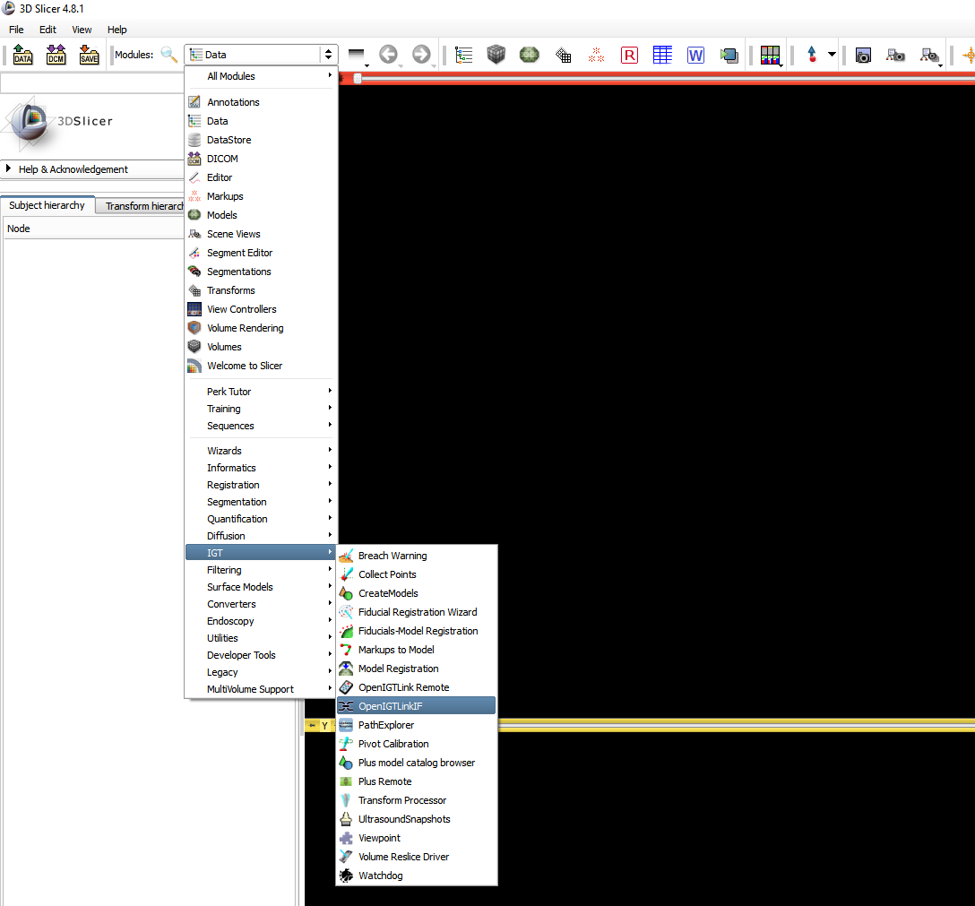
Connect from Slicer
1
2

Slide 34
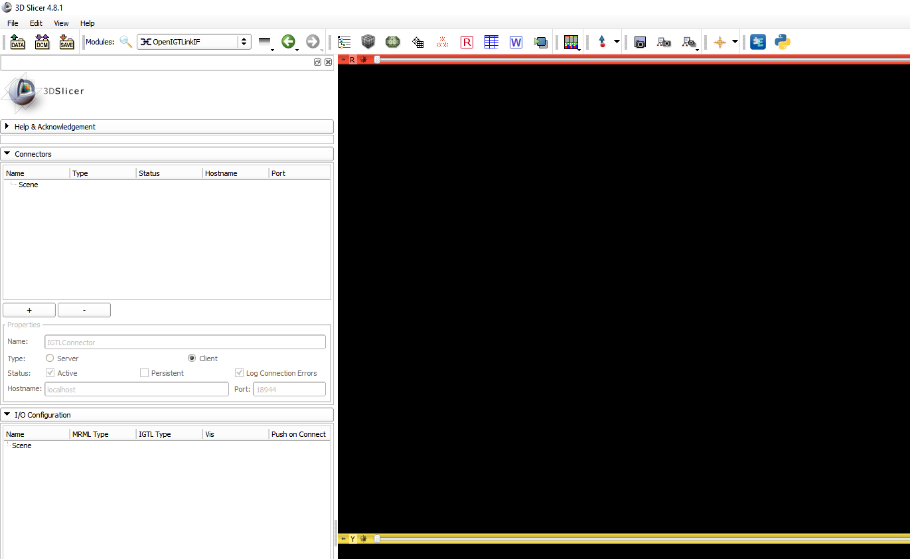
Connect from Slicer
1
2
See
Should populate with
Scene > IGTLConnector > IN > Image_Reference

Slide 35
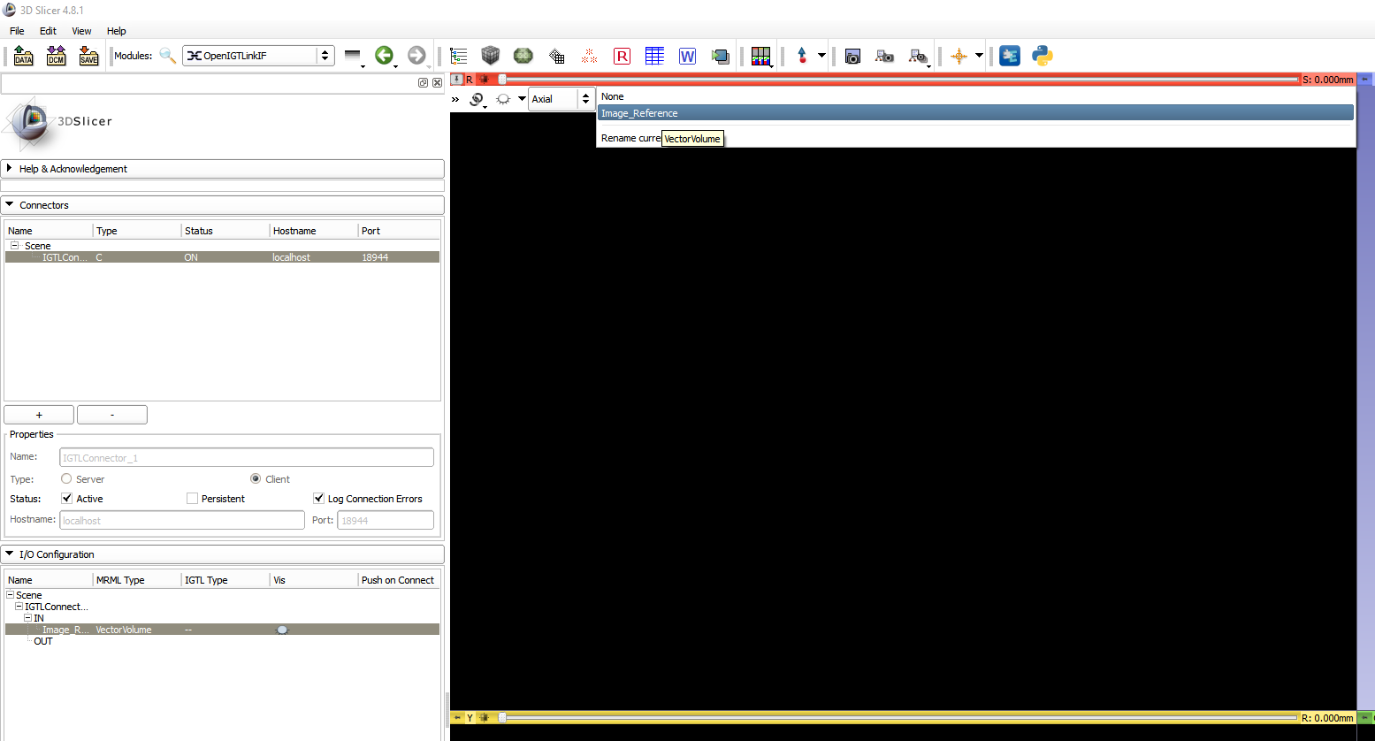
View Sent Images
1
2

Slide 36
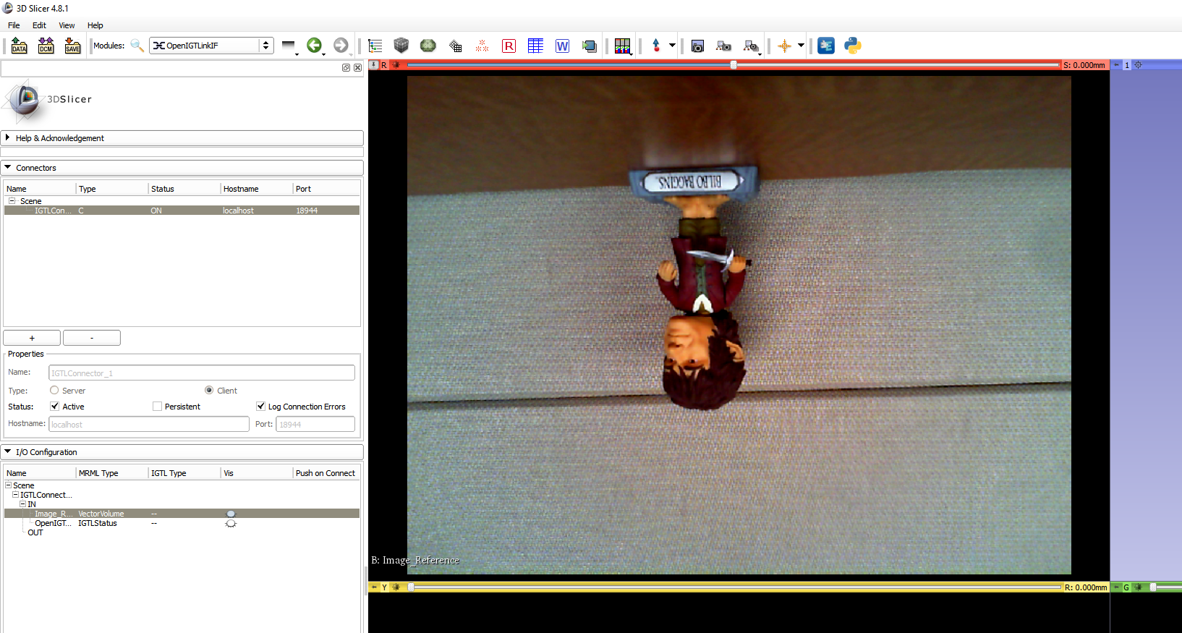
View Sent Images
1
See

Slide 37
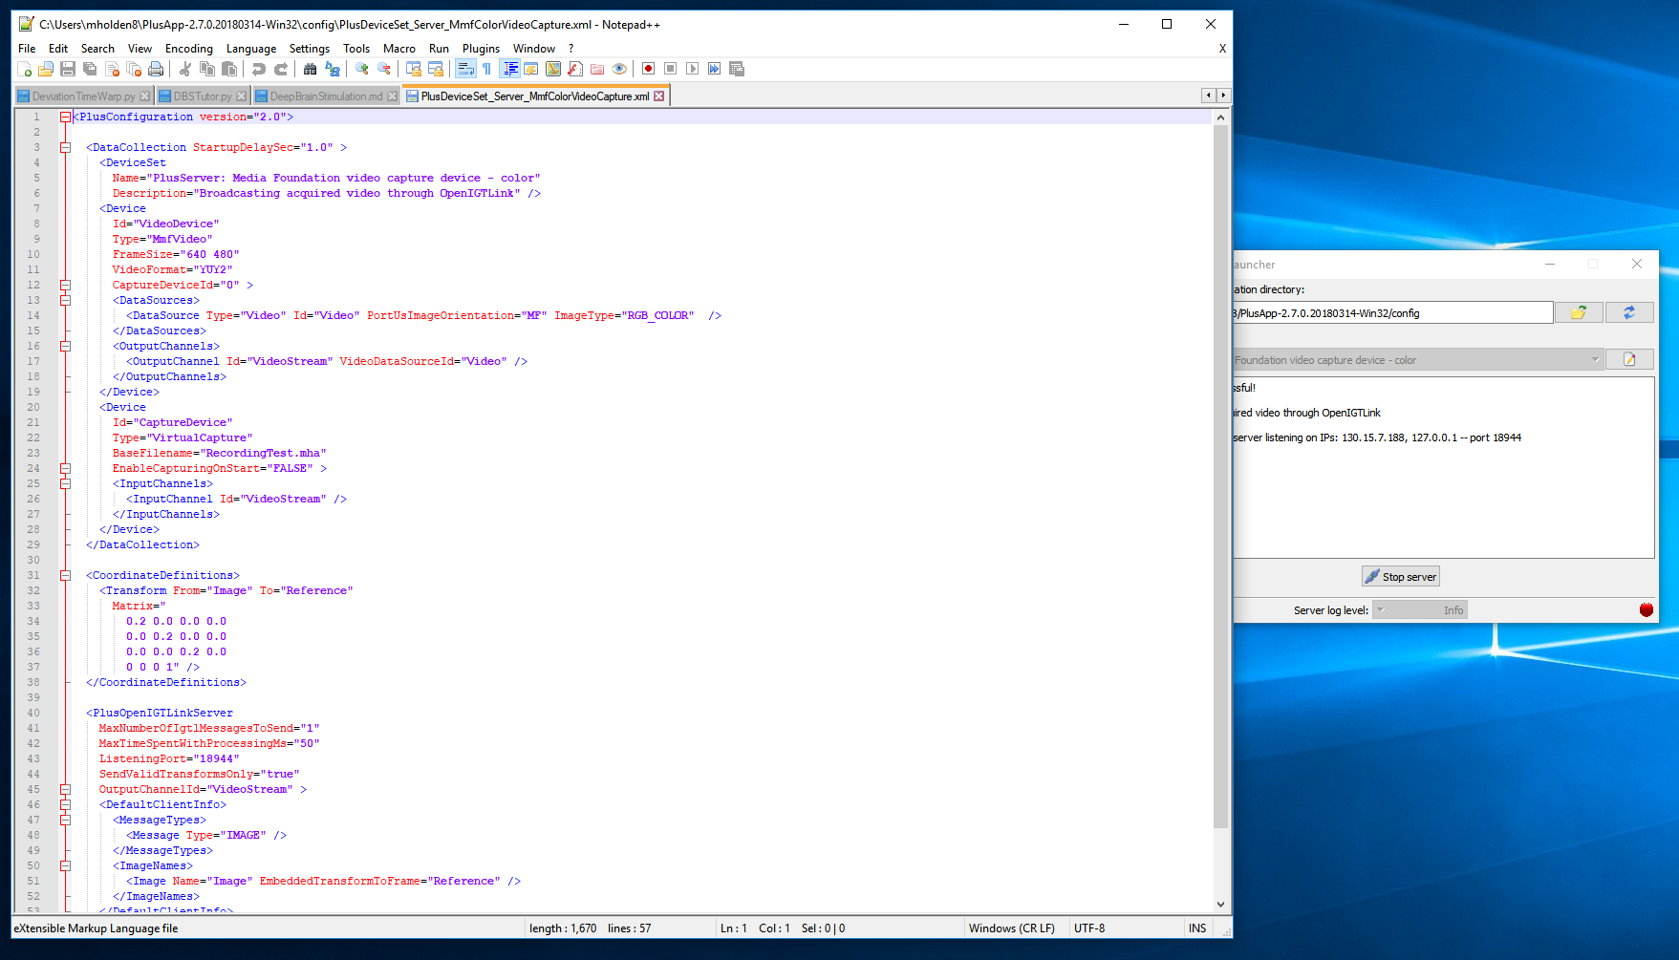
Edit Configuration Files
1
See

Slide 38
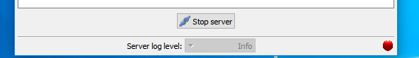
Orienting Image Properly
<Device
Id="VideoDevice"
Type="MmfVideo"
FrameSize="640 480"
VideoFormat="YUY2"
CaptureDeviceId="0" >
<DataSources>
<DataSource Type="Video" Id="Video" PortUsImageOrientation="UN" ImageType="RGB_COLOR" />
</DataSources>
<OutputChannels>
<OutputChannel Id="VideoStream" VideoDataSourceId="Video" />
</OutputChannels>
</Device>
Change to “UN”
(if this does not work, try “MN”)
2
1,3

Slide 39
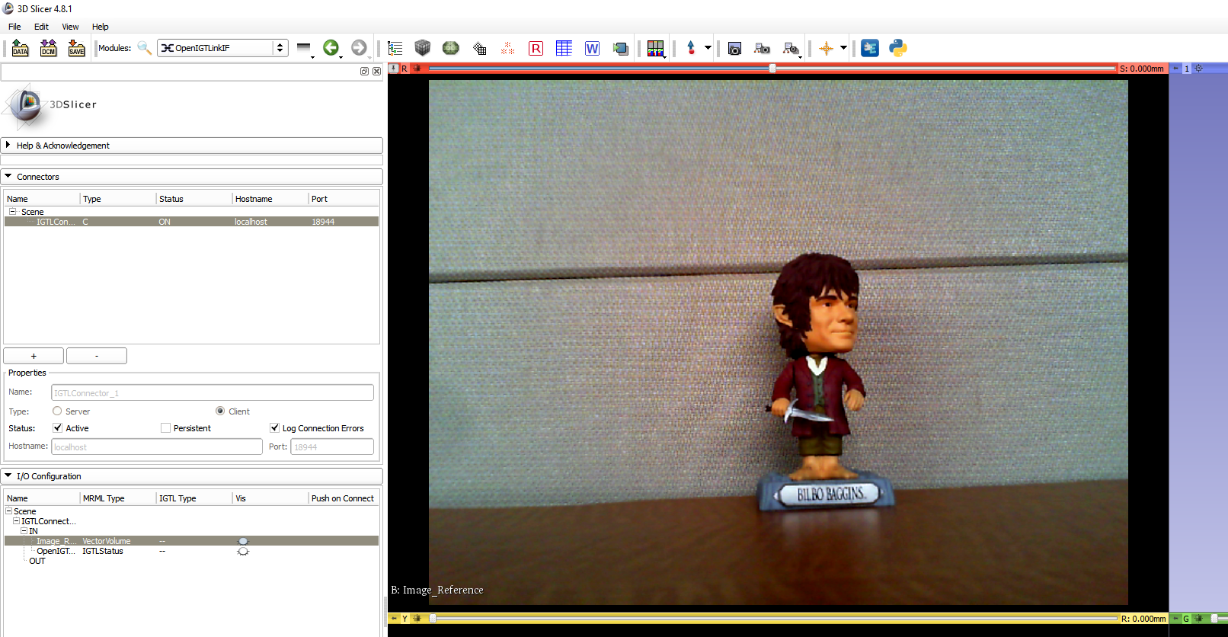
View Sent Images
See

Slide 40
Increase Image Resolution
Change to “1280 720”
Not all webcams support all resolutions (check for list of supported resolutions in PLUS message log)
<Device
Id="VideoDevice"
Type="MmfVideo"
FrameSize=“1280 720"
VideoFormat="YUY2"
CaptureDeviceId="0" >
<DataSources>
<DataSource Type="Video" Id="Video" PortUsImageOrientation="UN" ImageType="RGB_COLOR" />
</DataSources>
<OutputChannels>
<OutputChannel Id="VideoStream" VideoDataSourceId="Video" />
</OutputChannels>
</Device>
2
1,3

Slide 41
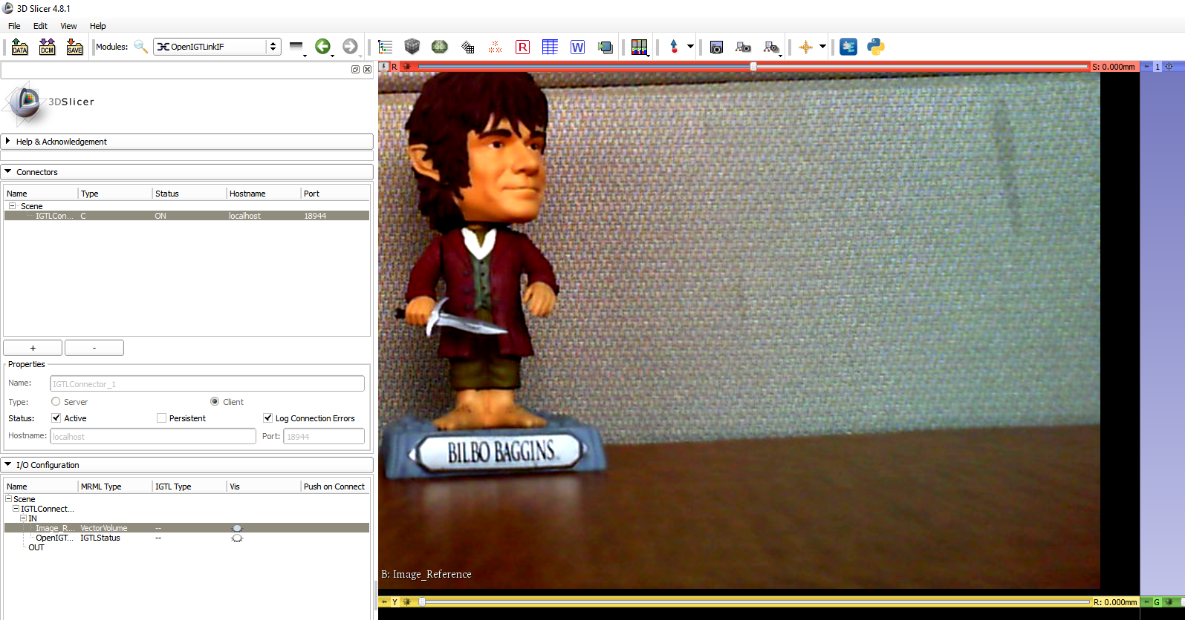
View Sent Images
Re-center
See

Slide 42
Crop Image
<Device
Id="VideoDevice"
Type="MmfVideo"
FrameSize=“1280 720"
VideoFormat="YUY2"
CaptureDeviceId="0" >
<DataSources>
<DataSource Type="Video" Id="Video" PortUsImageOrientation="UN“ ImageType="RGB_COLOR" ClipRectangleOrigin="300 300" ClipRectangleSize=“400 400" />
</DataSources>
<OutputChannels>
<OutputChannel Id="VideoStream" VideoDataSourceId="Video" />
</OutputChannels>
</Device>
Add ClipRectangleOrigin="300 300" ClipRectangleSize=“400 400"
2
1,3

Slide 43
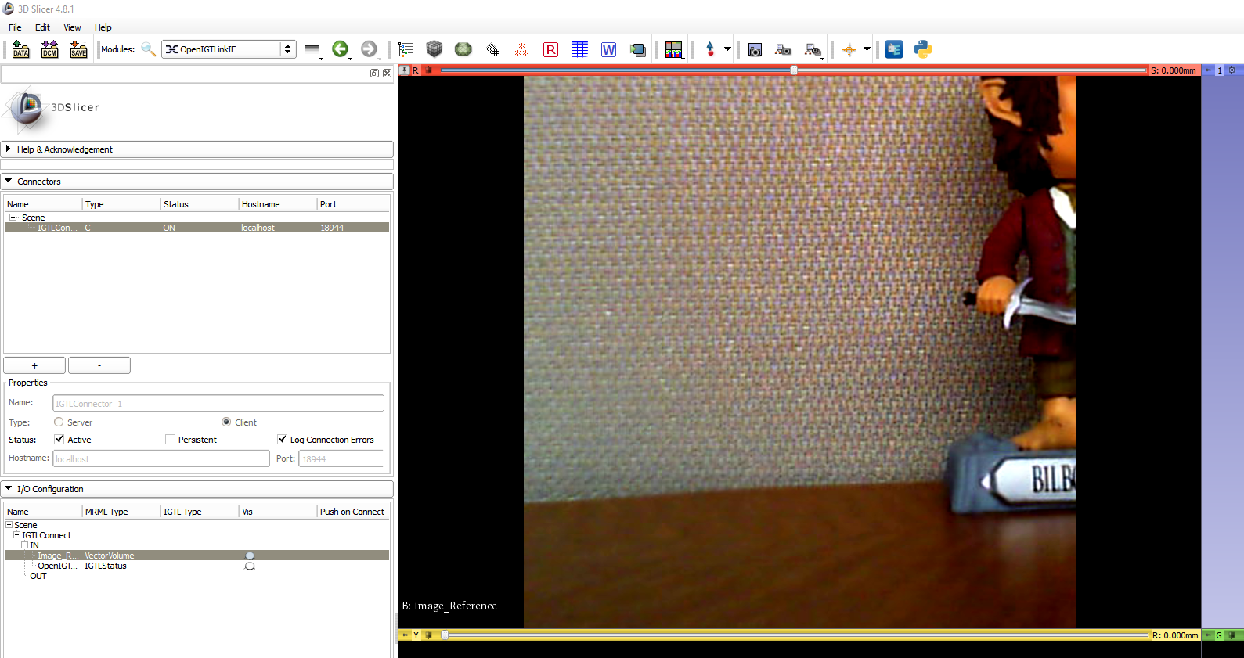
View Sent Images
Re-center
See

Slide 44
PLUS Configuration File Tutorial: Optical Marker Tracking

Slide 45
Start PLUS Server Launcher

Slide 46
Select Configuration File Directory
1
2
Directory where you installed PLUS (C:/Users/<YourUserName>/PlusApp-…-Win32/config)
Choose “config” subdirectory
3

Slide 47
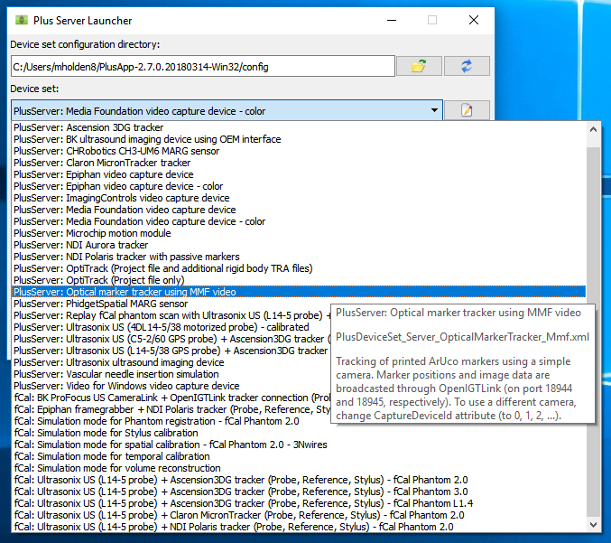
Choose Configuration for Optical Tracking
1
2

Slide 48
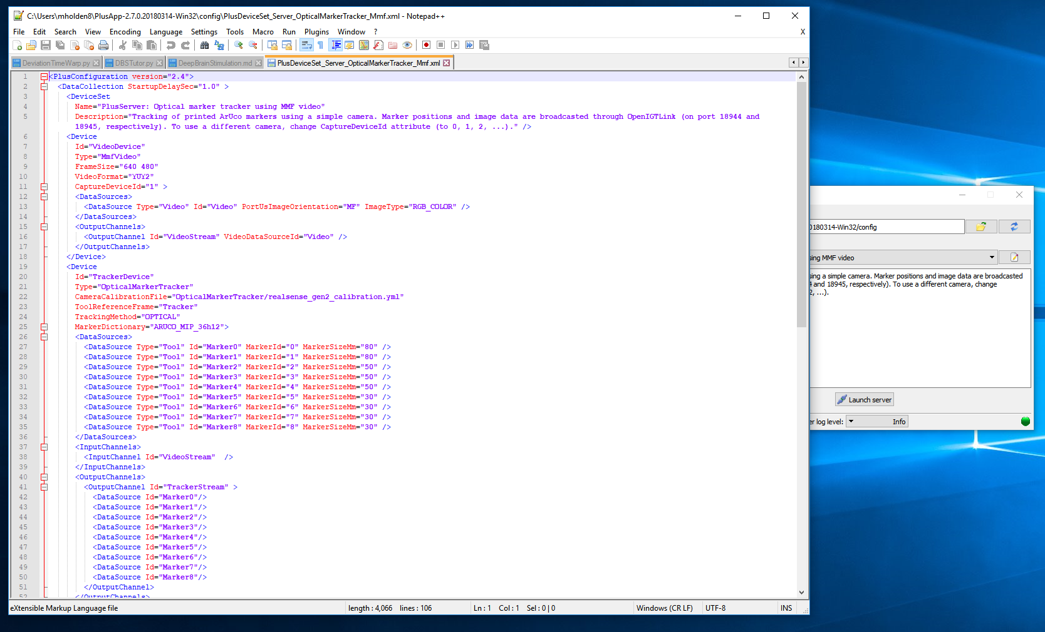
Edit Configuration Files
1
See

Slide 49
Remove Unused Markers
<Device
Id="TrackerDevice"
Type="OpticalMarkerTracker"
CameraCalibrationFile="OpticalMarkerTracker/realsense_gen2_calibration.yml"
ToolReferenceFrame="Tracker"
TrackingMethod="OPTICAL"
MarkerDictionary="ARUCO_MIP_36h12">
<DataSources>
<DataSource Type="Tool" Id="Marker0" MarkerId="0" MarkerSizeMm="80" />
<DataSource Type="Tool" Id="Marker1" MarkerId="1" MarkerSizeMm="80" />
</DataSources>
<InputChannels>
<InputChannel Id="VideoStream" />
</InputChannels>
<OutputChannels>
<OutputChannel Id="TrackerStream" >
<DataSource Id="Marker0"/>
<DataSource Id="Marker1"/>
</OutputChannel>
</OutputChannels>
</Device>
Remove here
We will only use two markers for our setup.
We use markers 0 and 1.
Remove here

Slide 50
Change Sent Transforms
<PlusOpenIGTLinkServer
MaxNumberOfIgtlMessagesToSend="1"
MaxTimeSpentWithProcessingMs="50"
ListeningPort="18944"
SendValidTransformsOnly="true"
OutputChannelId="TrackerStream" >
<DefaultClientInfo>
<MessageTypes>
<Message Type="TRANSFORM" />
</MessageTypes>
<TransformNames>
<Transform Name="Marker1ToMarker0" />
<Transform Name="Marker0ToTracker" />
<Transform Name="Marker1ToTracker" />
</TransformNames>
</DefaultClientInfo>
</PlusOpenIGTLinkServer>
Add here
Add the transform “Marker1ToMarker0”.
Remove here
We only have transforms from markers 0 and 1.

Slide 51
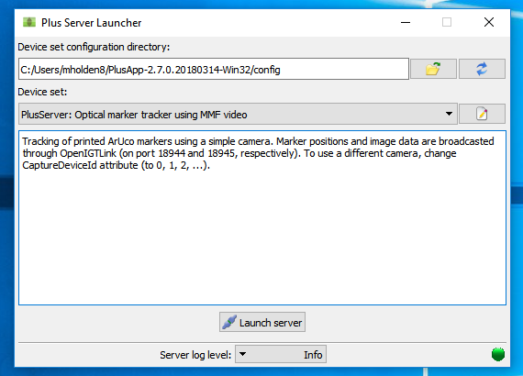
Launch Server
1
May take a few seconds…

Slide 52
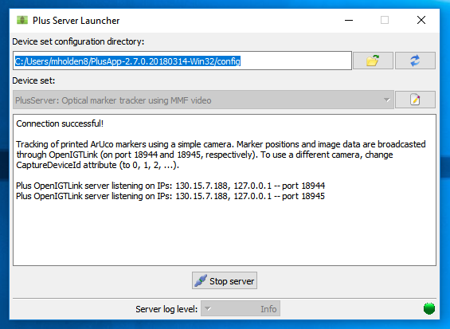
Check Connection
See

Slide 53
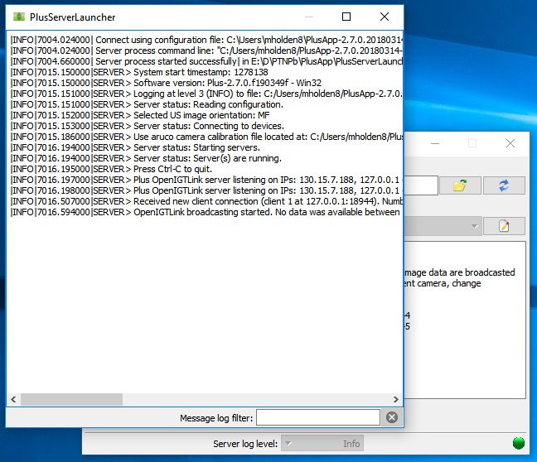
Check Message Log
1

Slide 54
Connect from Slicer
1
2

Slide 55
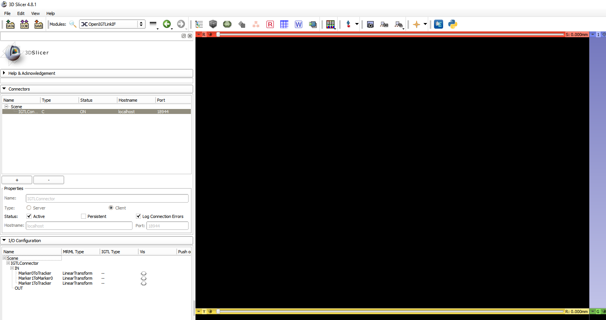
Connect from Slicer
1
3
2
Change to 18945.
See
Should populate with
Scene > IGTLConnector_1 > IN > Image_Image

Slide 56
Connect from Slicer
1
2
See
Should populate with
Scene > IGTLConnector > IN > Marker0ToTracker, Marker1ToTracker, Marker0ToMarker1

Slide 57
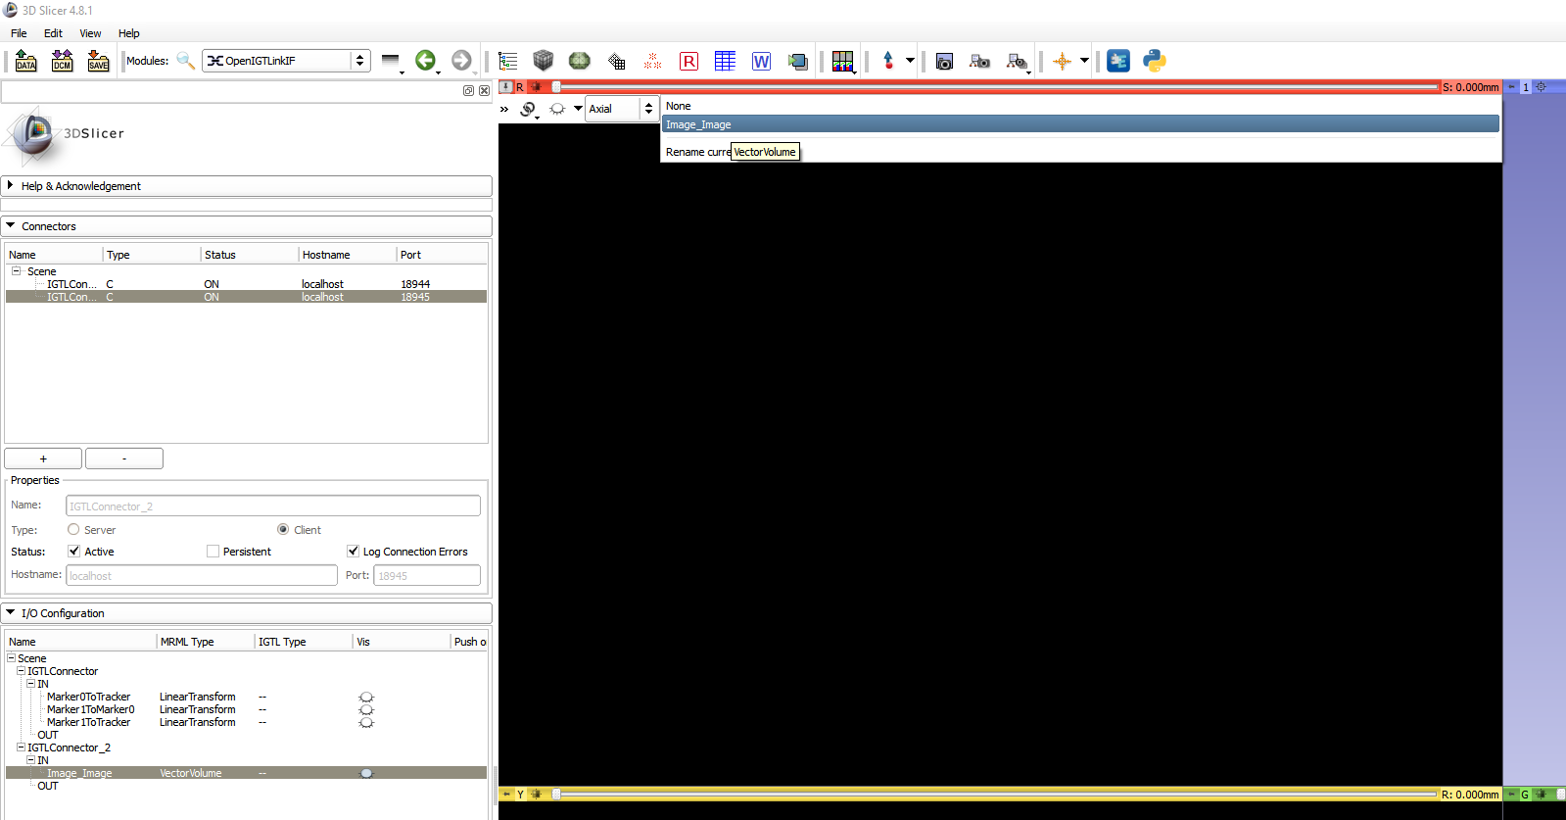
View Sent Images
1
2

Slide 58
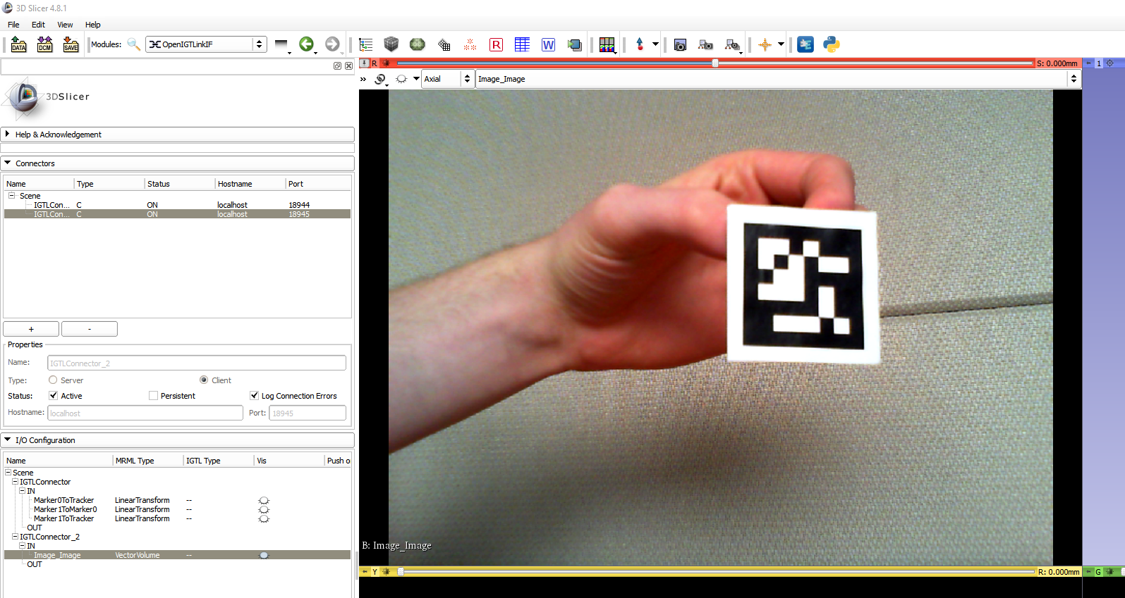
View Sent Images
1
See

Slide 59
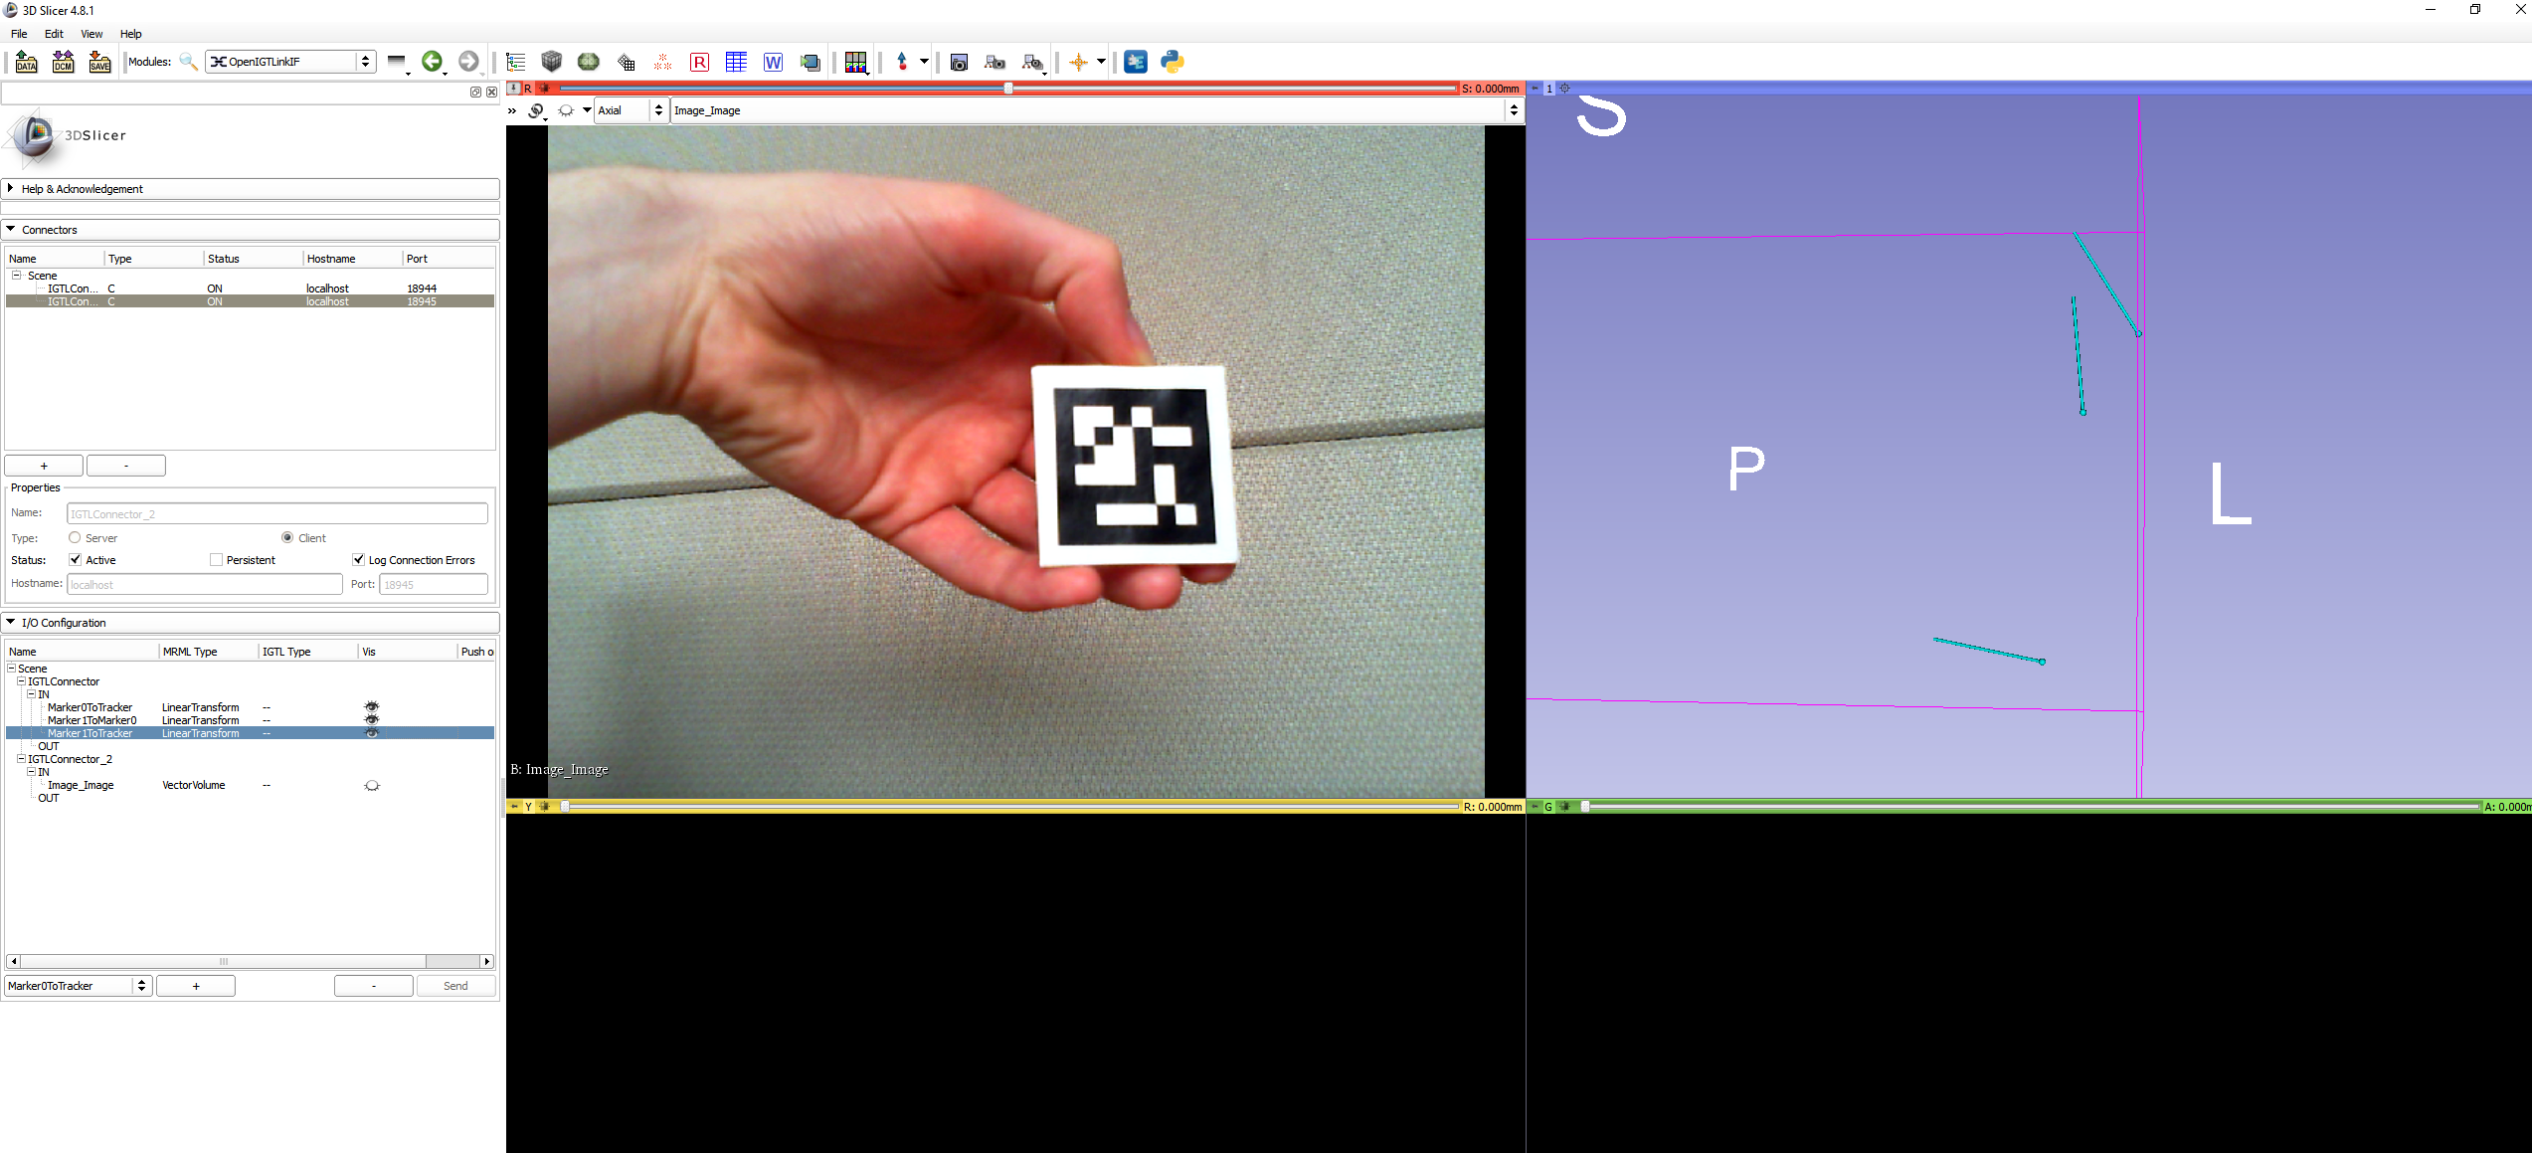
View Sent Transforms
4
See
1
2
3

Slide 60

SlicerIGT: Watchdog Module
1
2
3

Slide 61

SlicerIGT: Watchdog Module
1
2
3
See and hear

Slide 62
PLUS Remote Control From Slicer

Slide 63

Open Config File Directory
1

Slide 64

Add Config File to Slicer
1
2

Slide 65

View Config File
1
2

Slide 66

View Config File
1
See

Slide 67

Open PlusRemote Module
1
2

Slide 68

Create PlusServerLauncher
1

Slide 69

Add Server
1
2
3

Slide 70

Start Server
1

Slide 71

Check Plus
2
1

Slide 72

Save with Scene
1
2
3

Slide 73

Using plus.xml Extension
1

Slide 74
Recording Sequences in Slicer

Slide 75
3D Slicer: Sequences module
Plus
OpenIGTLink
3D Slicer
Sequences module
Save
Sequence metafile (igs.mha)
Save
Saved 3D Slicer sequence
(Many formats)

Slide 76
3D Slicer: Sequences Module
Node types:
Sequence browser
Controls recording + playback of multiple synchronized sequences
Can have many synchronized sequences
Sequence
Contains timestamps + data
Can record any data type in Slicer (Image, Transform, Model, Text, etc.)

Slide 77

3D Slicer: Sequences Module
Sequence browser
Entire video
Sequence
Individual tracks
Sequence
Sequence Browser
Sequence
Sequence

Slide 78

3D Slicer: Sequences Module
1
2
3

Slide 79

3D Slicer: Sequences Module
1
2

Slide 80


3D Slicer: Sequences Module
1
2
3
4

Slide 81

3D Slicer: Sequences Module
Start + Stop

Slide 82


3D Slicer: Sequences Module
2. Start + Stop
1

Slide 83

3D Slicer: Sequences Module
1
See

Slide 84
Acknowledgements
PLUS (www.plustoolkit.org)
Andras Lasso, Tamas Heffter, Adam Rankin, Csaba Pinter, Tamas Ungi, and Gabor Fichtinger, "PLUS: Open-source toolkit for ultrasound-guided intervention systems", IEEE Trans Biomed Eng. 2014 Oct;61(10):2527-37.
Kyle Sunderland (1krs1@queensu.ca)
Andras Lasso (lasso@queensu.ca)

